Slide 1

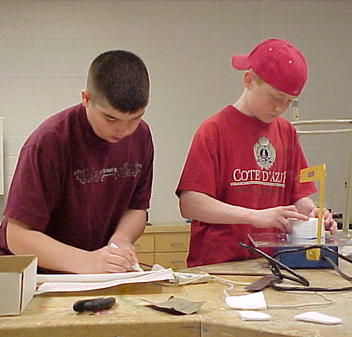
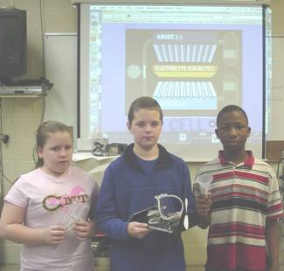
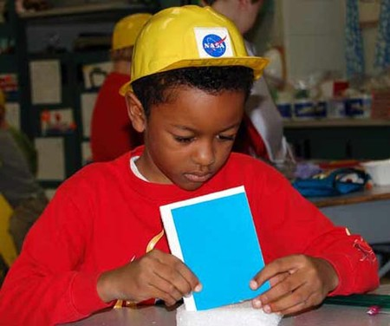
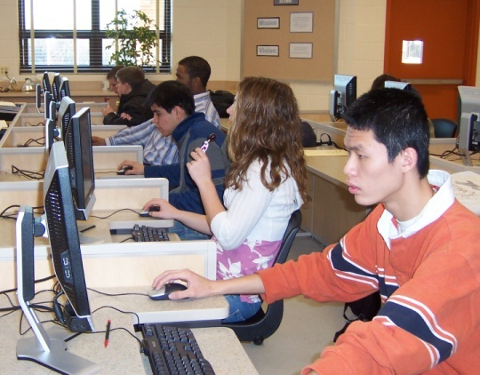


Advanced Design Applications
Problem-Solving Activity
Teacher Resource – First Five Days: Day 1
© 2014 International Technology and Engineering Educators Association
STEMCenter for Teaching and Learning™
Advanced Design Applications
Notes:
© International Technology Education Assoc
Slide #<number>
TITLE SLIDE
12/01/2009
STEMCenter for Teaching & Learning™ Engineering byDesign™

Slide 2

The BIG Idea
Big Idea:
Knowledge of basic technology and engineering skills and classroom routines will be essential for student success in the Learning Cycles, Preliminary and Primary Challenges of the various units in the Advanced Design Applications course. These units include Energy and Power, Transportation, Construction, and Manufacturing
© 2014 International Technology and Engineering Educators Association
STEMCenter for Teaching and Learning™
Advanced Design Applications
Notes:
[Authors: Please include teacher notes appropriately.]
© International Technology Education Assoc
Slide #<number>
12/01/2009
STEMCenter for Teaching & Learning™ Engineering byDesign™

Slide 3
What is the Problem?
Design a self-propelled helicopter that will safely transport passengers from one specified height to the floor.
Restrictions:
  You may only use the provided materials.
  You have one class period to complete
  the activity.
© 2014 International Technology and Engineering Educators Association
STEMCenter for Teaching and Learning™
Advanced Design Applications
Notes:
[Authors: Please include teacher notes appropriately.]
© International Technology Education Assoc
Slide #<number>
12/01/2009
STEMCenter for Teaching & Learning™ Engineering byDesign™

Slide 4
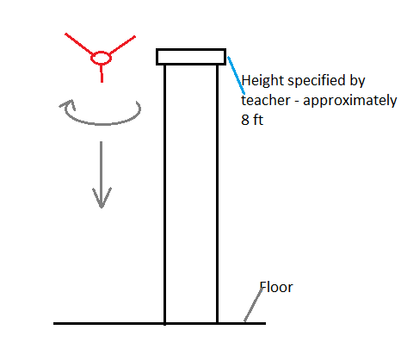
Challenge Layout
© 2014 International Technology and Engineering Educators Association
STEMCenter for Teaching and Learning™
Advanced Design Applications
Notes:
[Authors: Please include teacher notes appropriately.]
© International Technology Education Assoc
Slide #<number>
12/01/2009
STEMCenter for Teaching & Learning™ Engineering byDesign™

Slide 5




Materials
You must construct a vehicle to travel from point A to point B under its own power using only the following materials:
  12” of Masking tape
  2 paper clips (passengers)
  1 rubber bands
  2 pieces of paper
© 2014 International Technology and Engineering Educators Association
STEMCenter for Teaching and Learning™
Advanced Design Applications
Notes:
[Authors: Please include teacher notes appropriately.]
© International Technology Education Assoc
Slide #<number>
12/01/2009
STEMCenter for Teaching & Learning™ Engineering byDesign™

Slide 6
What are your Guidelines?
You can only use the materials provided.
It must travel in a vertical path with the axis of rotation remaining perpendicular to the floor.
The helicopter must make at least four turns.
You cannot assist the helicopter with spinning.
The passengers must arrive safely without falling off the helicopter.
The helicopter must remain in one piece.
© 2014 International Technology and Engineering Educators Association
STEMCenter for Teaching and Learning™
Advanced Design Applications
Notes:
[Authors: Please include teacher notes appropriately.]
© International Technology Education Assoc
Slide #<number>
12/01/2009
STEMCenter for Teaching & Learning™ Engineering byDesign™

